Slide 1
Introduction to Programming Language II(Java)
Fariha Zahin

Slide 2
Motivation: Why Exception Handling Matters?
Programs often face abnormal situations during execution
Common causes include:
Invalid user input
Missing files
Network failures
Division by zero

Slide 3
Motivation: Why Exception Handling Matters?
Without handling, programs may terminate abruptly
Exception handling improves:
Program robustness
Maintainability
Code readability
Separation of normal logic and error-handling logic

Slide 4
What is Exception Handling?
Exception: An event that disrupts the normal flow of the program.
Handling: Mechanism to detect and handle runtime problems.
Examples:
Division by zero
Accessing invalid array index
Reading a non-existent file
**Java provides a robust exception handling model using try, catch, throw, throws, and finally.

Slide 5
Types of Exceptions
Checked Exception
Checked at compile time.
Must be handled using try-catch or declared using throws
Program will not compile if ignored
Examples: IOException, SQLException

Slide 6
Types of Exceptions
2. Unchecked Exception
Occur at runtime.
Not checked at compile time
Usually caused by programming errors
Examples: NullPointerException, ArithmeticException

Slide 7
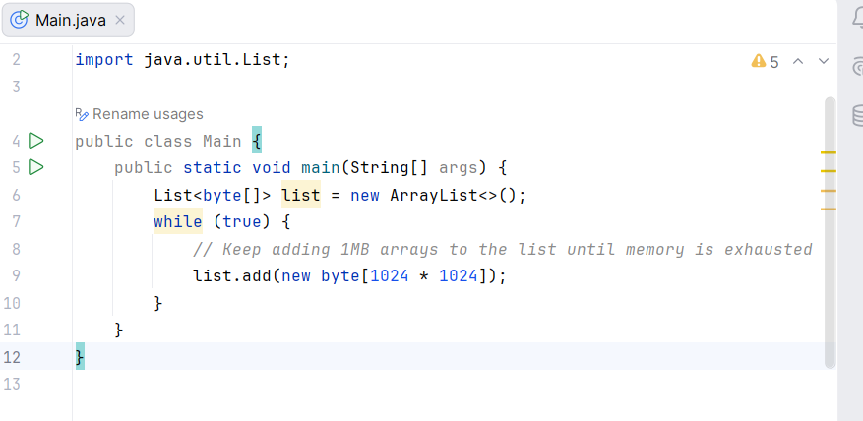
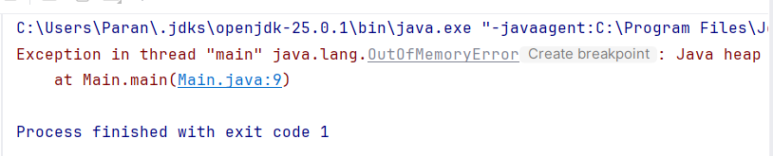
Error:
Serious system-level problems
Not meant to be handled by applications
Example: OutOfMemoryError

Slide 8
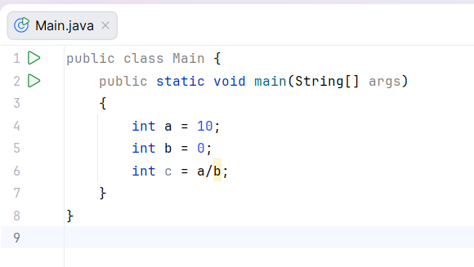
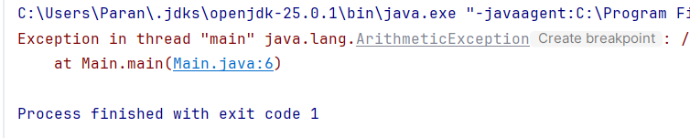
ArithmeticException
Division by zero

Slide 9
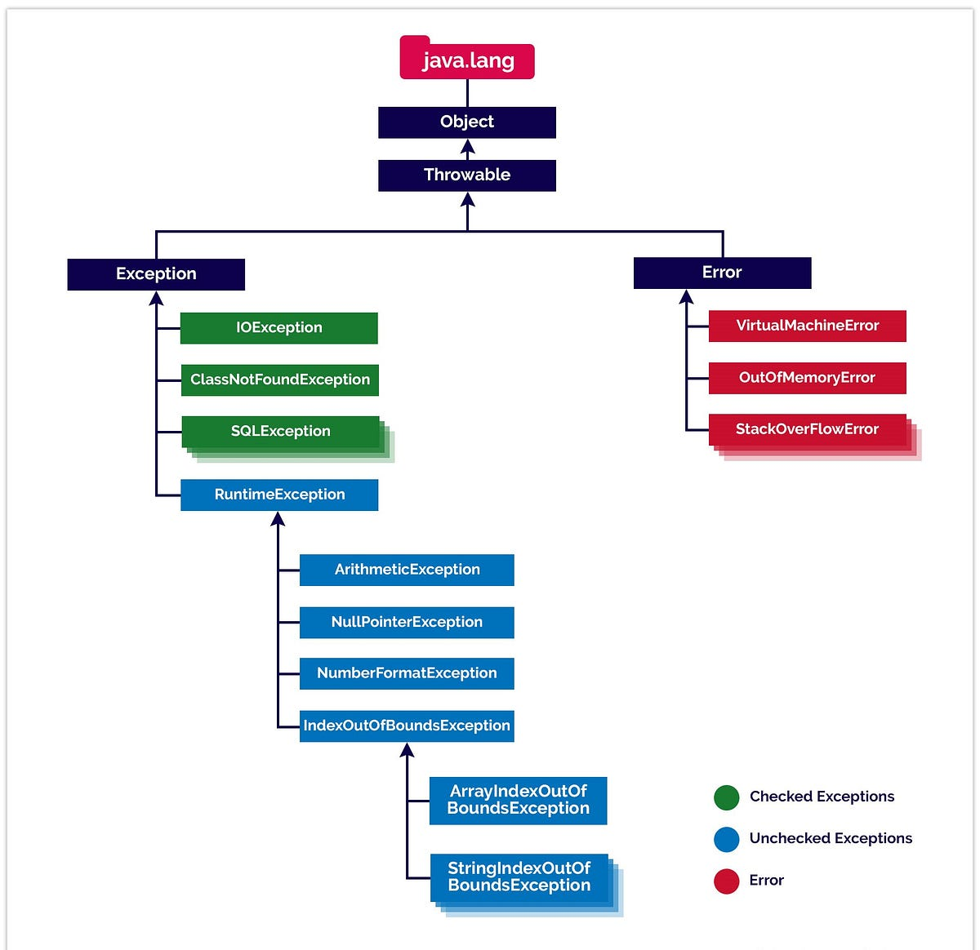

Slide 10
Difference Between Error and Exception
Feature | Error | Exception
Origin | Outside the control of program | Within program’s scope
Recovery | Not usually recoverable | Can be handled using code
Examples | OutOfMemoryError, StackOverflowError | IOException, NumberFormatException
Type | Unchecked | Checked or Unchecked
Use of try-catch | Not advised | Strongly recommended

Slide 11
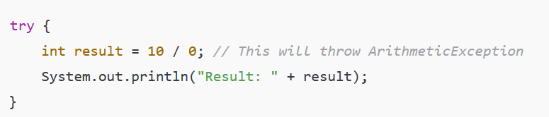
5 Keywords in Exception Handling
try – Block to monitor for exceptions
catch – Handles the exception
throw – Used to explicitly throw an exception
throws – Declares exceptions
finally – Always executes after try-catch
try block
Used for: Wrapping code that might throw an exception. Rules: Must be followed by either a catch block, a finally block, or both.

Slide 12
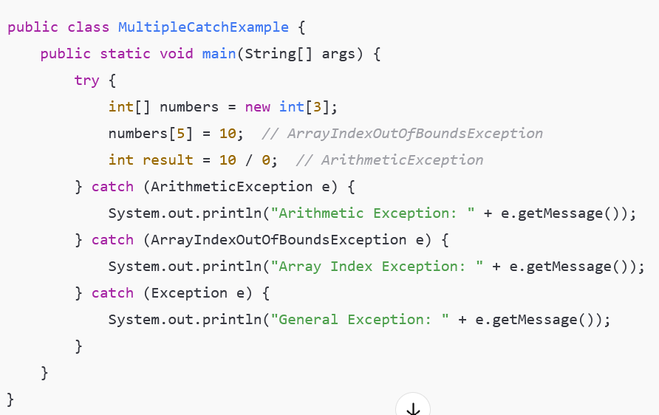
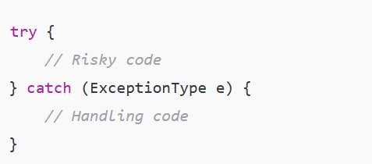
catch block
Used for: Handling exceptions that are thrown inside the try block. Rules: You can use multiple catch blocks for different exception types.
Only the first exception that occurs is handled. In this case, the array index error happens first, so the division is never reached.

Slide 13
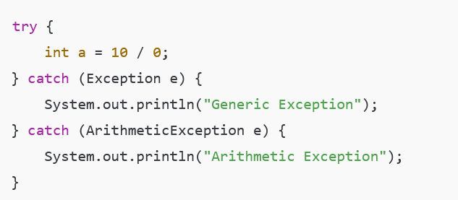
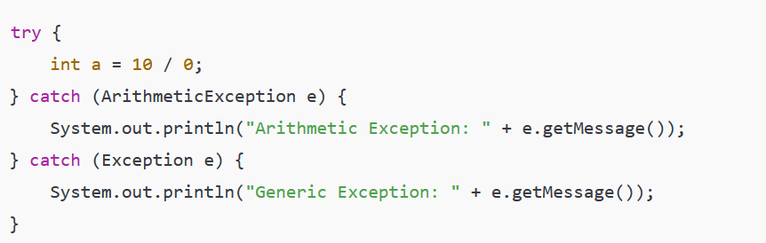
Why Child Exception First, Parent Last
Java matches exceptions from top to bottom.
When the parent class (Exception) comes before the child classes, the child catch blocks become unreachable, and this results in a compile-time error.
Correct Order: Write the more specific exceptions first, and the general one (Exception) at the end.
Wrong Order (Compile-Time Error)
Correct Order (Child First, Parent Last)

Slide 14
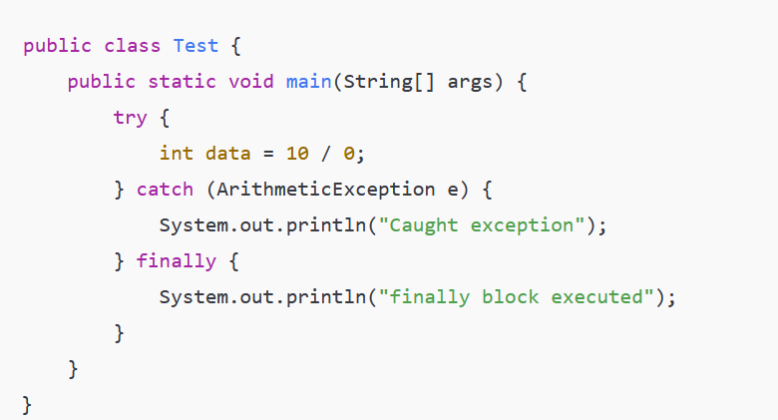
finally block
Used for: Code that should always run, whether an exception occurs or not. Rules: Used for cleanup like closing files or releasing resources.

Slide 15
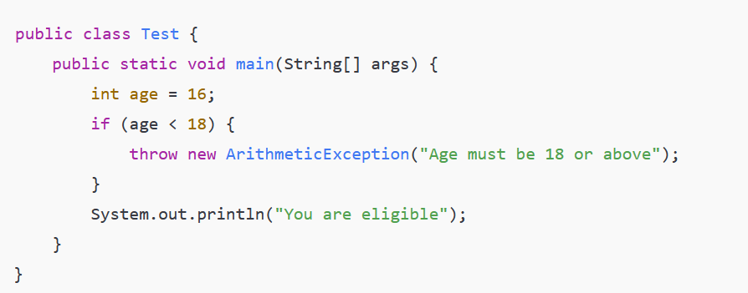
throw keyword
Used for: Manually throwing an exception (built-in or custom). Rules: Only one exception can be thrown at a time using throw.

Slide 16
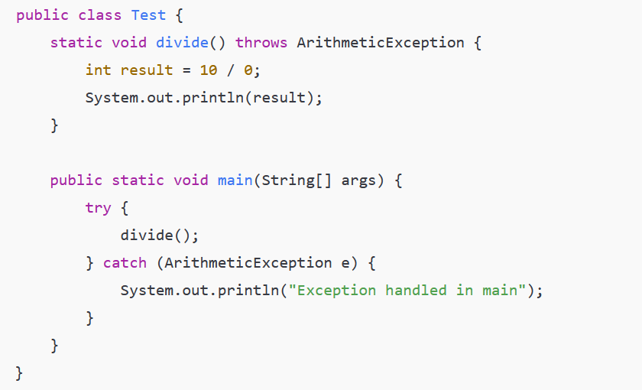
throws keyword
Used for: Declaring exceptions a method might throw. Rules: Helps inform the caller to handle the exception.

Slide 17
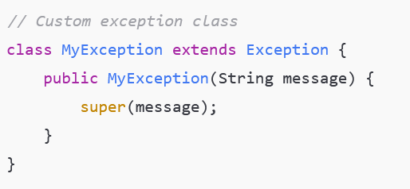
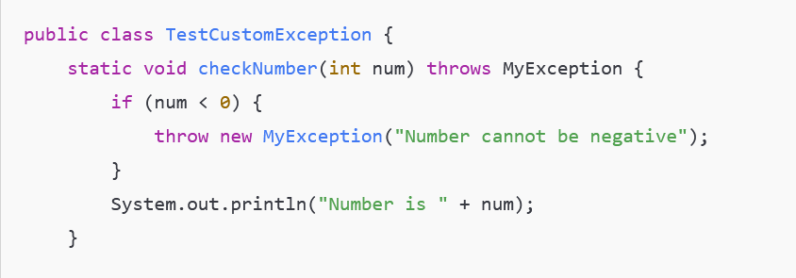
Custom User-Defined Exception in Java Java allows you to create your own exception classes by extending the built-in Exception class (or any of its subclasses). This helps you represent application-specific errors clearly.
Custom exceptions usually extend Exception (checked exceptions) or RuntimeException (unchecked exceptions).
You can add constructors and custom messages.
When your code detects a specific error condition, you throw your custom exception.
The caller handles it like any other exception using try-catch.

Slide 18
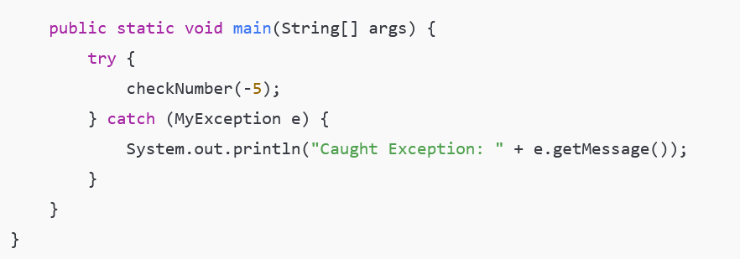
This code defines a custom exception class named MyException without any constructor. The method check throws this exception when the input number is less than zero. In the main method, check is called inside a try block. If the exception occurs, it is caught in the catch block, and a simple message is printed. Since the custom exception has no constructor with a message, no detailed error message is available. This shows that defining a constructor is optional but useful for passing error details.

